Slide 1

How To Evaluate a Research Paper
Tom Oates PhD FRCP
Royal London Hospital

Slide 2
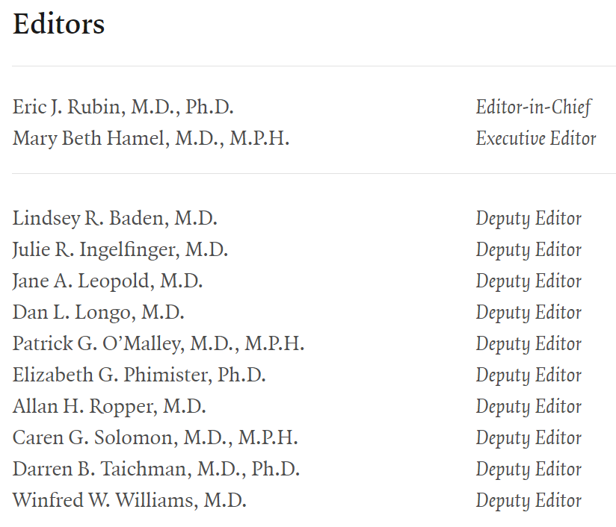
Haven’t Published Papers Been Evaluated Already…?
“You can write anything in a book”
Andrew Davenport, circa 2008

Slide 3
6 Questions To Ask About Every Paper
What Did The Authors Want To Know?
What Did They Do?
Why Did They Do It That Way?
What Do The Results Show?
How Were The Results Interpreted?
What Should Happen Next?
🫘
🩺
🧭
🧬
🔰
🎒
Carey et al, PLOS Comp Bio, 2020

Slide 4
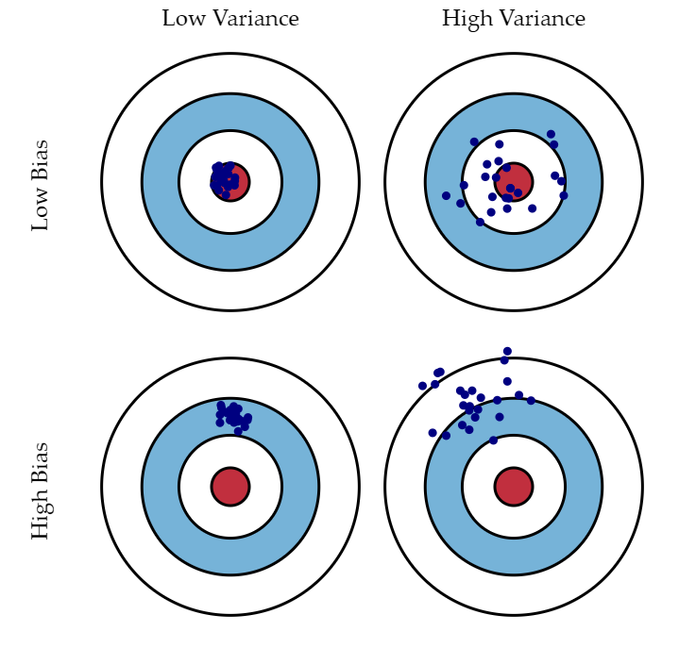
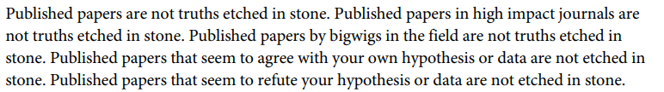
Criticism & Kindness
Trash 💔🚮
Carey et al, PLOS Comp Bio, 2020
Bias
Assumptions in the experiment
Variance
Sensitivity to changes
Irreducible
Unlimited money, resource etc

Slide 5
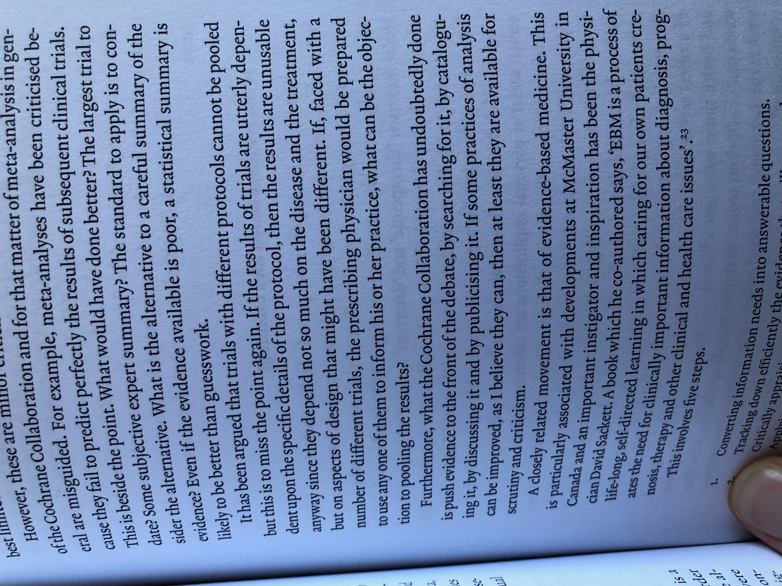
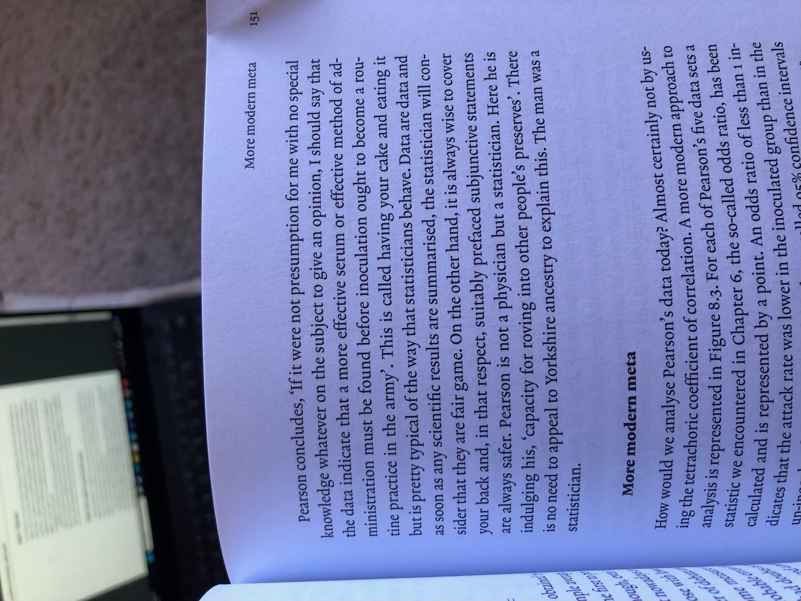
Criticism & Kindness
Love 🥰💓
Senn, Dicing With Death

Slide 6
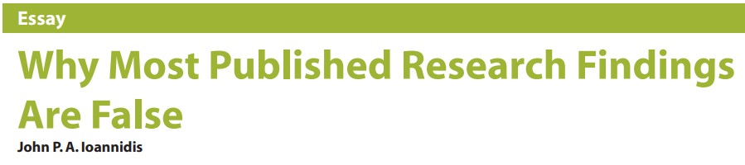
Reasons To Be Sceptical
Small Studies
RCTs v Prediction Studies
Small Effect Sizes
Smoking & CV disk v Genetic risk in polygenic disease
Large Number of, and Less Selected, Tests
Confirmatory v Hypothesis Generating
Flexibility of Design
RCT, Standards & Methods, Endpoints v New Methods, Selective Reporting etc
Vested Interest
Hype
Bandwagons & Gotchas
Ioannidis, PLoS Medicine, 2005

Slide 7
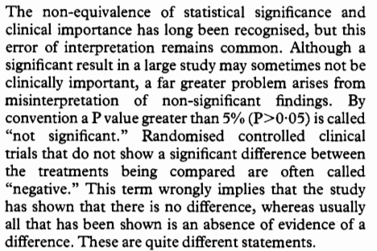
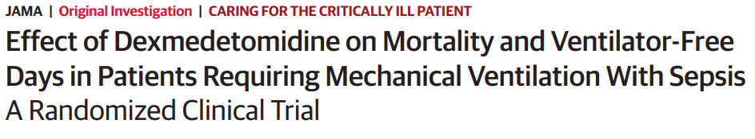
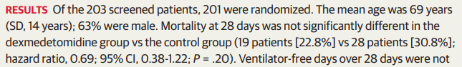
Two Key Concepts: P Values
“How should we interpret large p-values?”
“By finding more data”
RA Fisher
Absence of evidence is not evidence of absence
Bland & Altman, BMJ, 1995;
Kawazoe et al, JAMA, 2017

Slide 8
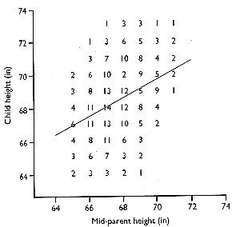

Two Key Concepts: Regression To The Mean
$$slope of regression line=r\frac{sX}{sY}$$
A change of 1 standard deviation in X is associated with a change of r standard deviations in Y
Therefore
Unless X & Y are exactly linearly related, r < 1
Bland & Altman, BMJ, 1994

Slide 9
Two Key Concepts: Regression To The Mean
What Does This Mean for Medicine?
Scenario | Role of Regression To The Mean?
Treatment of “high” levels (uPCR, BP, Chol etc) | - If we select for a high value & measure again - Mean of extreme group will be closer to the population mean - Correlation < 1 (variation, error)
Relating change to an initial value | - Regression to the mean is greater in those whose initial value is most extreme
Decision analysis/Peer review | - If an examining panel has less than perfect agreement then the panel and the treating clinician will too - Therefore, all panels show is that decisions are difficult and clinicians don’t always agree

Slide 10
Further Reading
Bland & Altman’s Statistics Notes BMJ series
Stephen Senn, Dicing With Death, Cambridge University Press
Seamus O’Mahony, Can Medicine Be Cured? The Corruption of a Profession, Apollo
Frank Harrell’s blog https://www.fharrell.com/post/errmed/
Carey et al., Ten Simple Rules For Reading A Scientific Paper, Plos Comput Biol, 16(7), e1008032
Ioannidis, Why Most Published Research Findings Are False, Plos Medicine, 2(8), e124

